Slide 1
A manual on
‘HOW TO DREAM’
With FM
By Diana Simkauskaite
Pearl Orchid

Slide 2
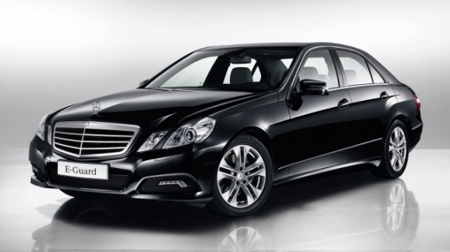
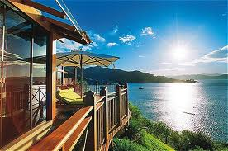
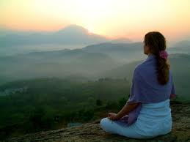
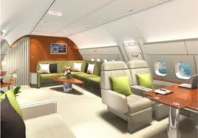
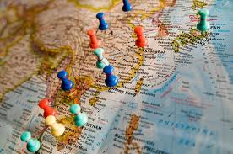
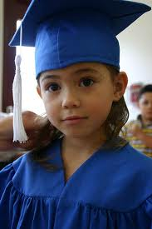

Slide 3
Make no little plans, they have no magic to stir men's blood and will not be realized.
Daniel Burnham
DREAM big

Slide 4
The best reason for having dreams is that in dreams no reasons are necessary.
Ashleigh Brilliant
DREAM IMPOSSIBLE

Slide 5
Cherish your visions and you dreams, as they are the children of your soul; the blueprints of your ultimate achievements.
Napoleon Hill
CREATE YOUR OWN blueprint

Slide 6
Dreams will show you where you are and where you are going. They reveal your destiny.
Carl Jung
Have a destination

Slide 7
Dream and give yourself permission to envision a You that you choose to be.
Joy Page
Be who you want to be

Slide 8
All our dreams can come true, if we have the courage to pursue them.
Walt Disney
Dare to dream

Slide 9
If you want to make your dreams come true, the first thing you have to do is wake up.
J.M. Power
Get out of bed…
…and make it happen!

Slide 10
Goals are dreams with deadlines.
Diana Scharf Hunt
SET YOUR GOALS

Slide 11
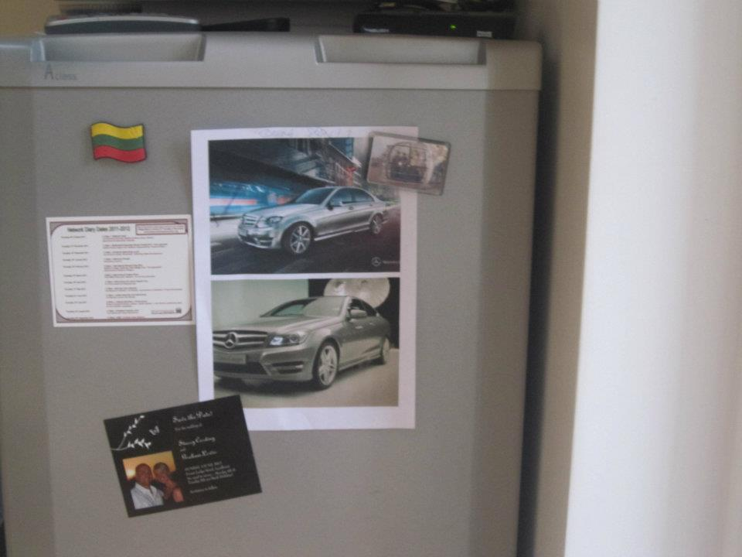
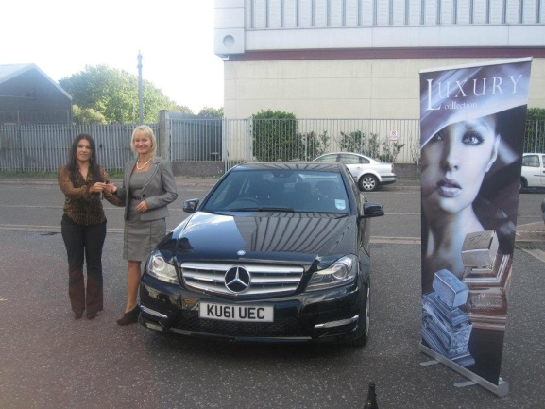
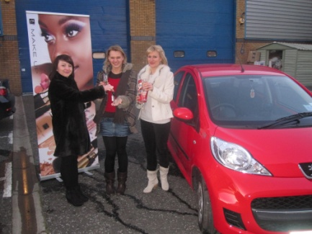
Real life
TESTIMONIALS
from FM
Having a dream’s picture on the fridge, meant getting their Mercedes’ arrivals confirmation in next three months!
Birute&Ian
Talking about the plans/dreams made more resources available.
Diana
Believing in yourself and your dreams makes all the difference!
Irena&Diana

