Slide 1

OPPORTUNITY

Slide 2
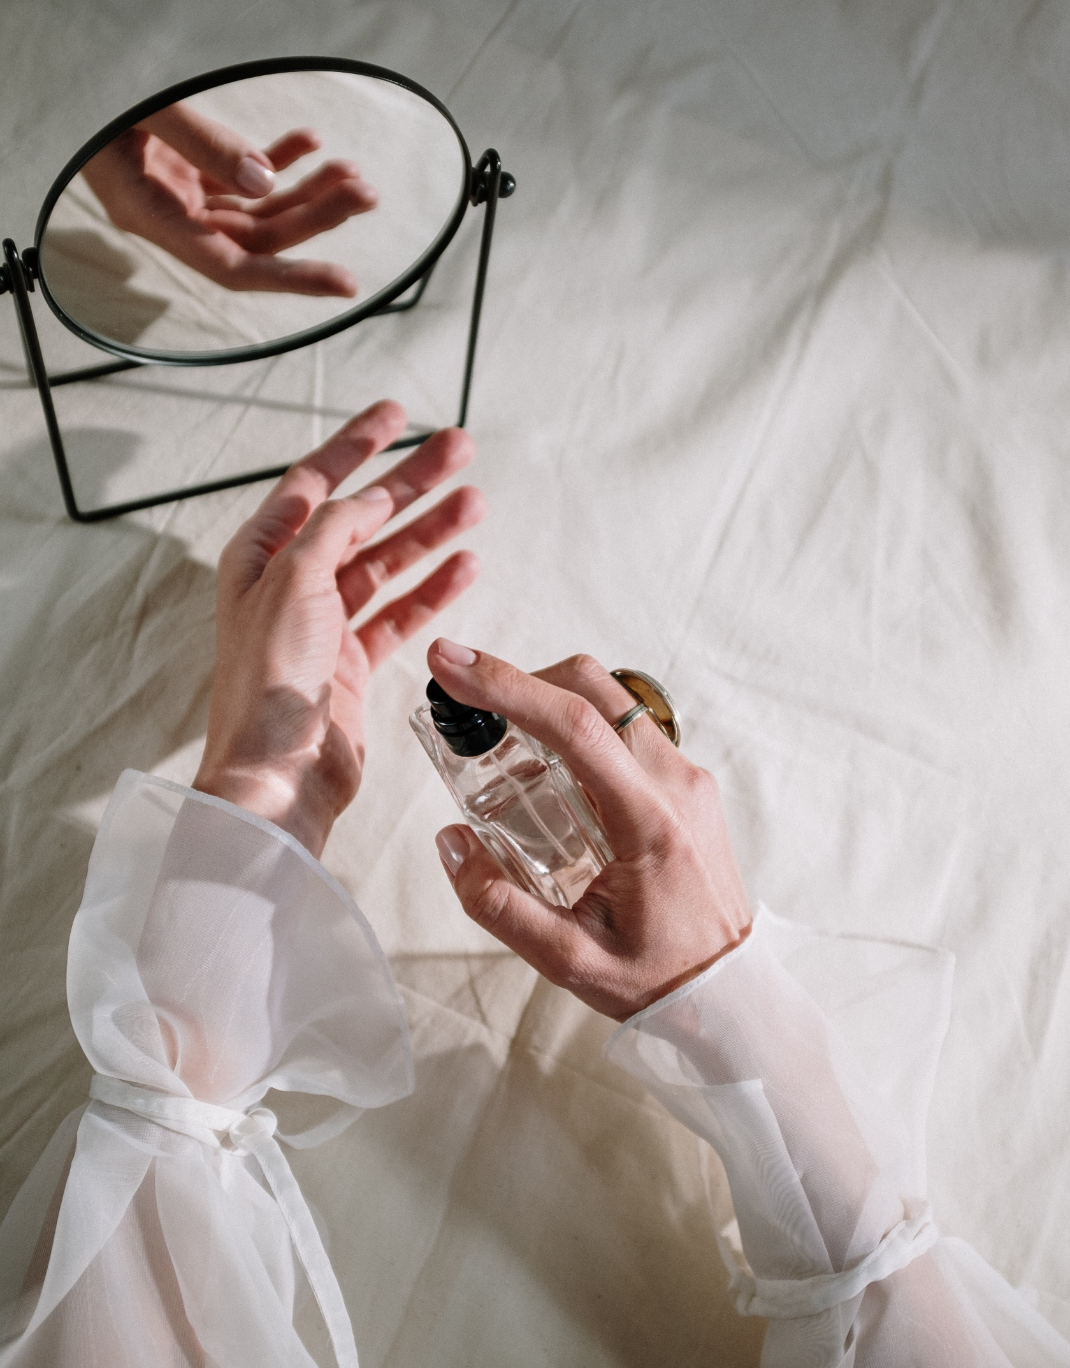

WOULD YOU LIKE TO BE PAID FOR RECOMMENDATIONS?

Slide 3

Would You Like To Be Paid For Work That You Did Years Ago?

Slide 4

Would You Like To Be Paid While You Sleep?

Slide 5

Who Are We?

Slide 6

Network Marketing

Slide 7
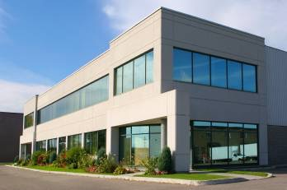
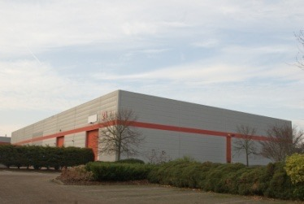
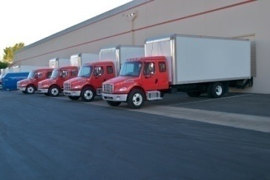
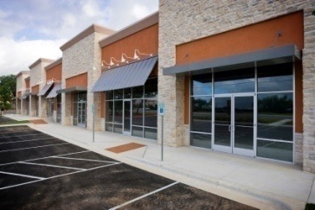

Conventional Marketing
(A) Company
(B) National Wholesaler or Broker
(C) Regional Wholesaler
(A) – (D) = DISTRIBUTION COSTS
Rent, Rates, Insurance, Staff, Profit Margin, Shipping, ADVERTISING, etc
(D) Retailer
Distribution costs can account for up to 85% of the final price paid by the consumer
Consumer

Slide 8




FM Network Marketing
(B) National Wholesaler or Broker
(C) Regional Wholesaler
FM decided to market their unique product ranges to consumers using Independent Distributors…
…and to pay them substantial commissions for producing product sales from retailing and team building
(D) Retailer
RETAIL TO MAKE A PROFIT
Business Partner
Consumer

Slide 9
Global Success!
40 countries around the world with Shipping Worldwide! 2 500 000 Business Partners worldwide

Slide 10
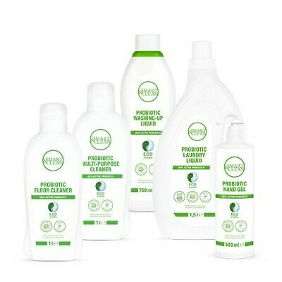
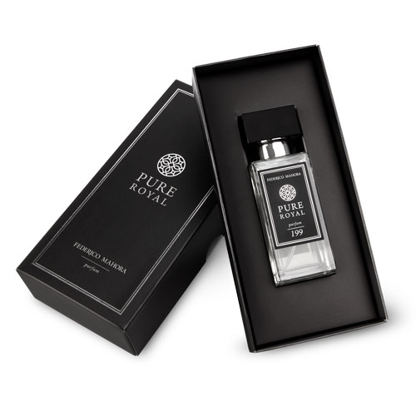

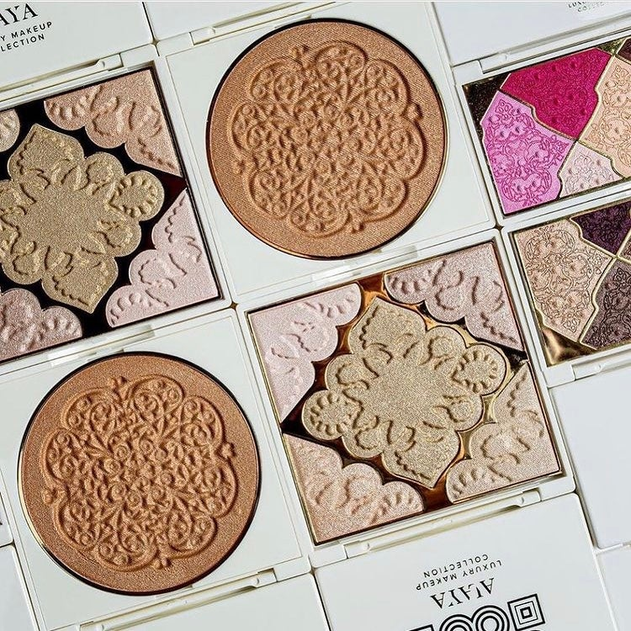

Highest Quality Products

Slide 11
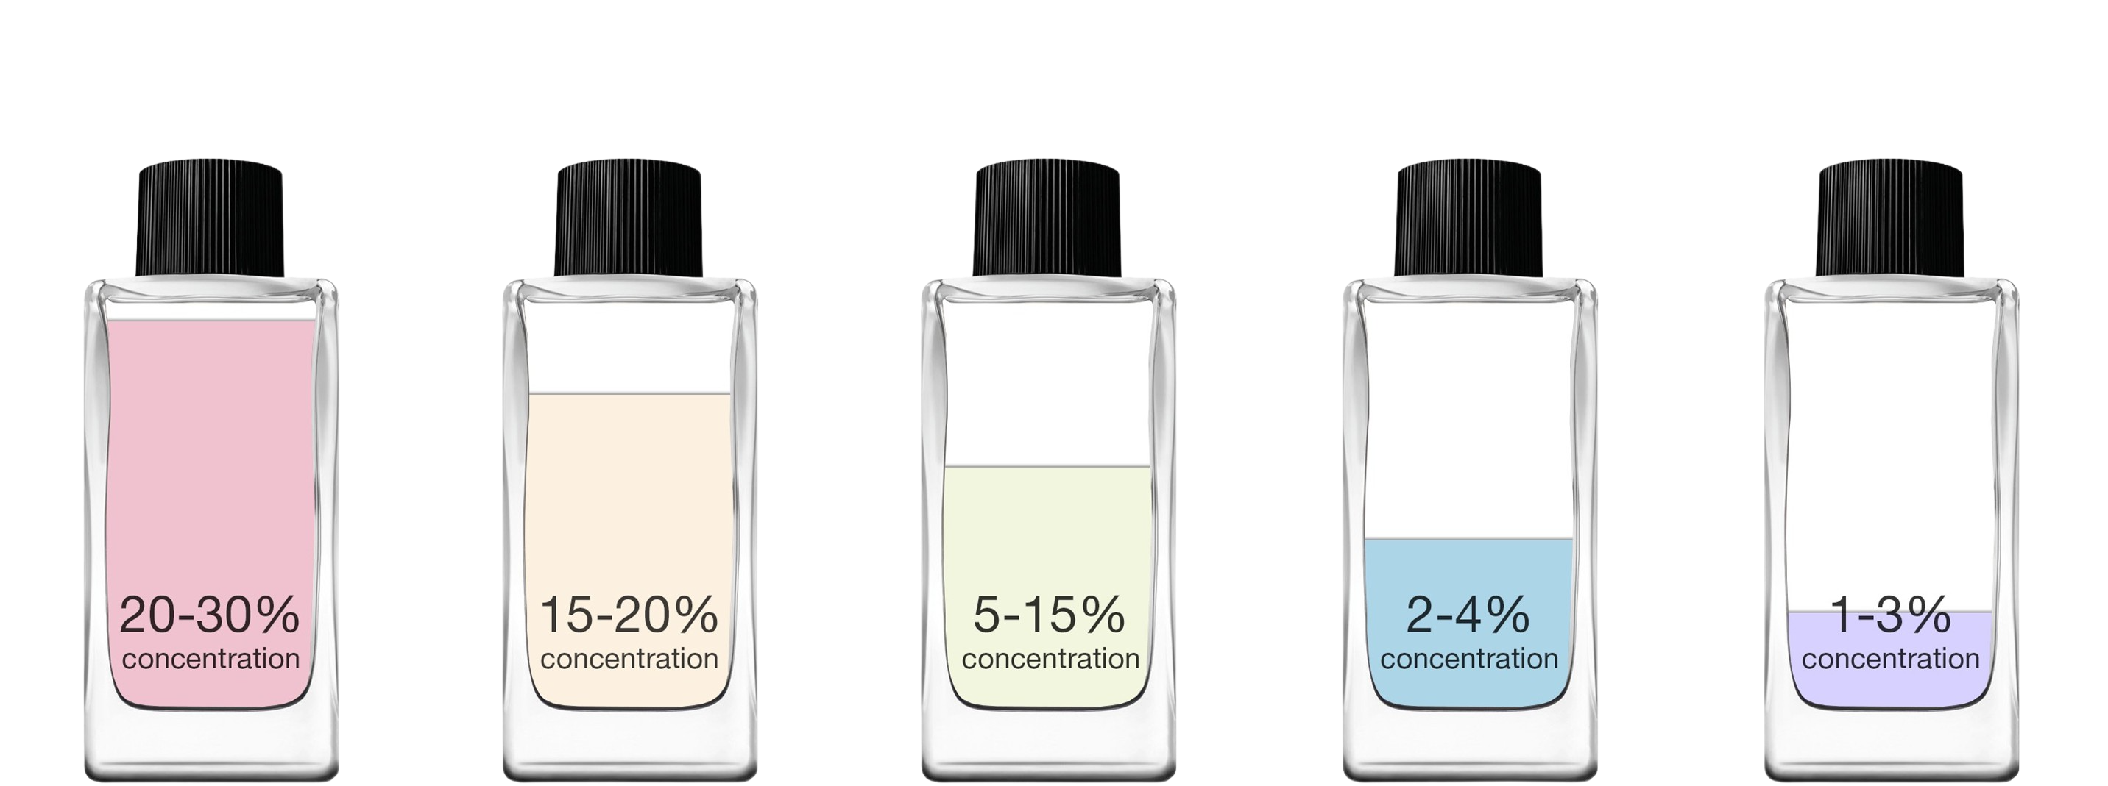

Extraordinary Quality
Perfume (Parfum)
Eau de Parfum (EDP)
Eau de Toilette (EDT)
Eau de Cologne
(EDC)
Eau Fraiche
Lasts for
upto 6-8 hours
Lasts for
upto 4-5 hours
Lasts for
upto 2-3 hours
Lasts for
upto 2 hours
Lasts for
upto 2 hours

Slide 12
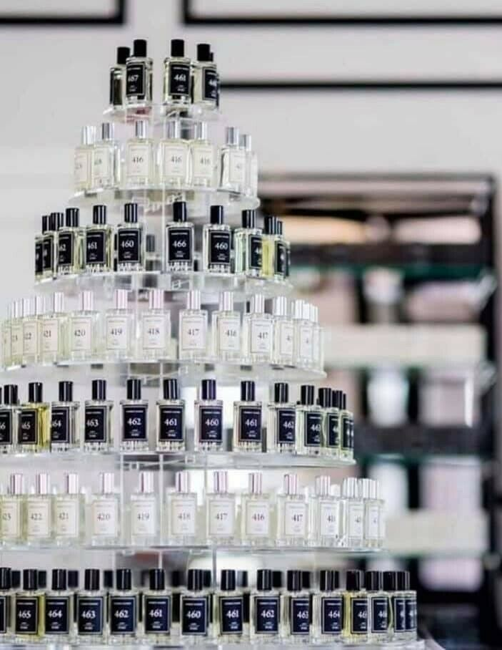
HOW DO YOU EARN WITH FM WORLD?
SOMETHING FOR EVERYONE
RETAIL SALES family, friends, work colleagues
DIRECT SELLING businesses, offices, salons
FUNDRAISING local, national or international
PRODUCT PARTIES
SOCIAL MEDIA

Slide 13
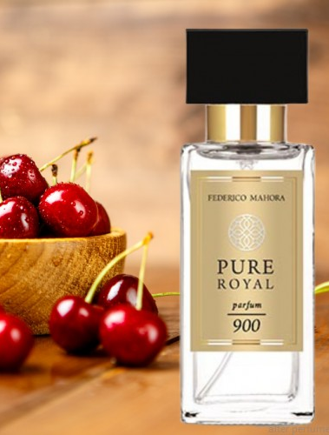
1
HOW DO YOU EARN WITH FM WORLD?
RETAILING
You take orders from customers
Place orders with FM office
Supply products to customers
Earn ~30% profit from sales

Slide 14
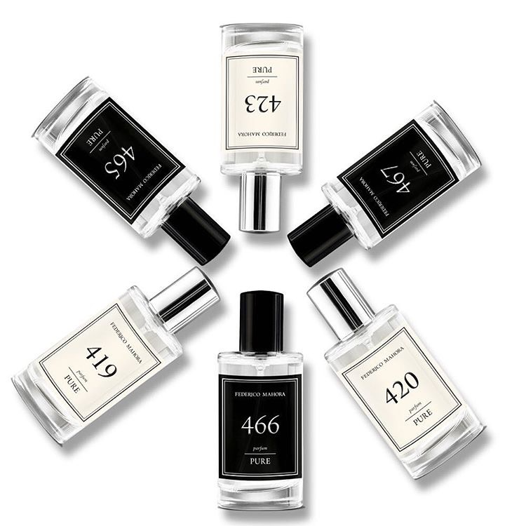
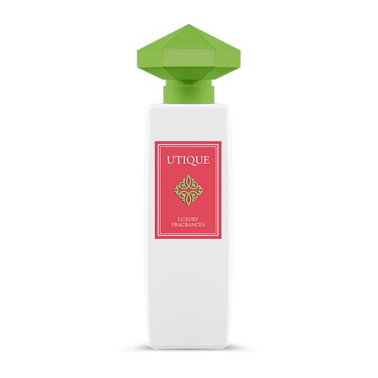
Retail Profit
PURE perfumes
cost £15
retail £21.50
profit £6.50
UTIQUE perfumes
PURE ROYAL perfumes
cost £57.60
retail £82.50
cost £21.60
retail £31
profit £24.90
profit £9.40

Slide 15
2
TEAM BUILDING
MAGNOLIA PROGRAM
PURE perfumes
cost £15
retail £21.50
profit £6.50
60 points
UTIQUE perfumes
PURE ROYAL perfumes
cost £57.60
retail £82.50
cost £21.60
retail £31
profit £24.90
profit £9.40
285.8 points
86.4 points

Slide 16

2
TEAM BUILDING
MAGNOLIA PROGRAM
Commission is based on the volume of sales of your ENTIRE TEAM each month
As your team volume grows so does your commission percentage
21%
30,000p.
18%
20,400p.
15%
12,000p.
12%
7,200p.
9%
3,600p.
6%
1,200p.
3%
300p.
£5 - £1,000 per month

Slide 17
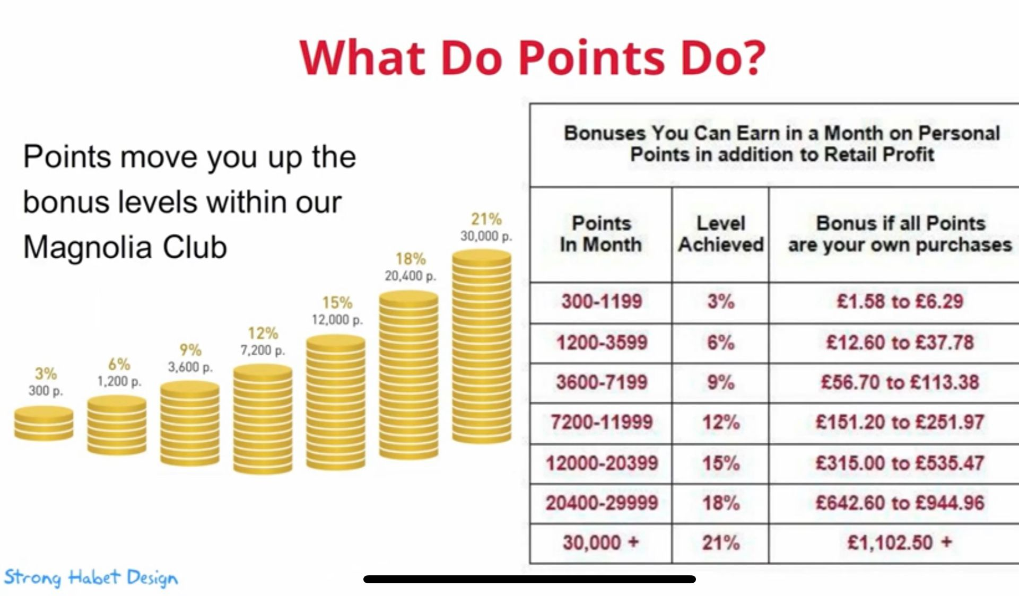
2
TEAM BUILDING
MAGNOLIA PROGRAM

Slide 18
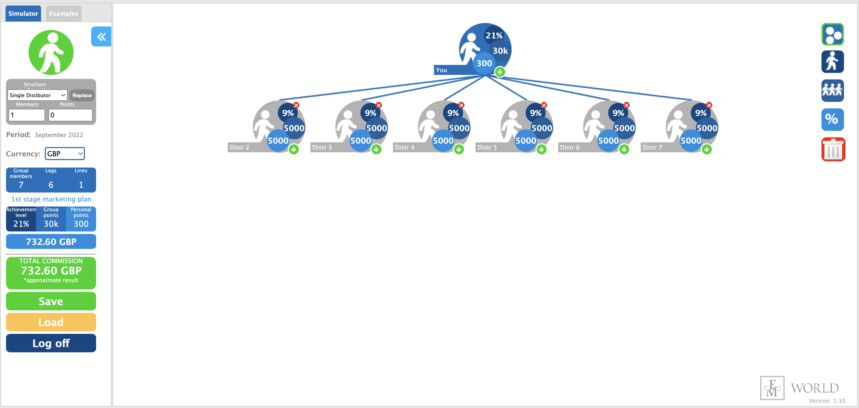
2
TEAM BUILDING
MAGNOLIA PROGRAM
Team Commission £732 + Welcome Home £435 = £1,167

Slide 19

3
Leadership bonus
ORCHID CLUB
Pearl Orchid
Amaranth Orchid
Golden Orchid
Diamond Orchid
$1,500 - $30,000 per month

Slide 20


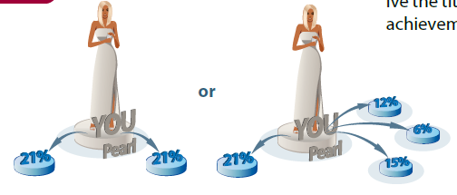
Pearl Orchid
You receive the Pearl Orchid title if you sponsor at least one group with an achievement level of 21%, while the rest of your network has at least 20,000 points of turnover. Alternatively, you can also receive the title if you sponsor two groups that have an achievement level of 21% each.
£1,000
per month
Minimum 20,000 points

Slide 21

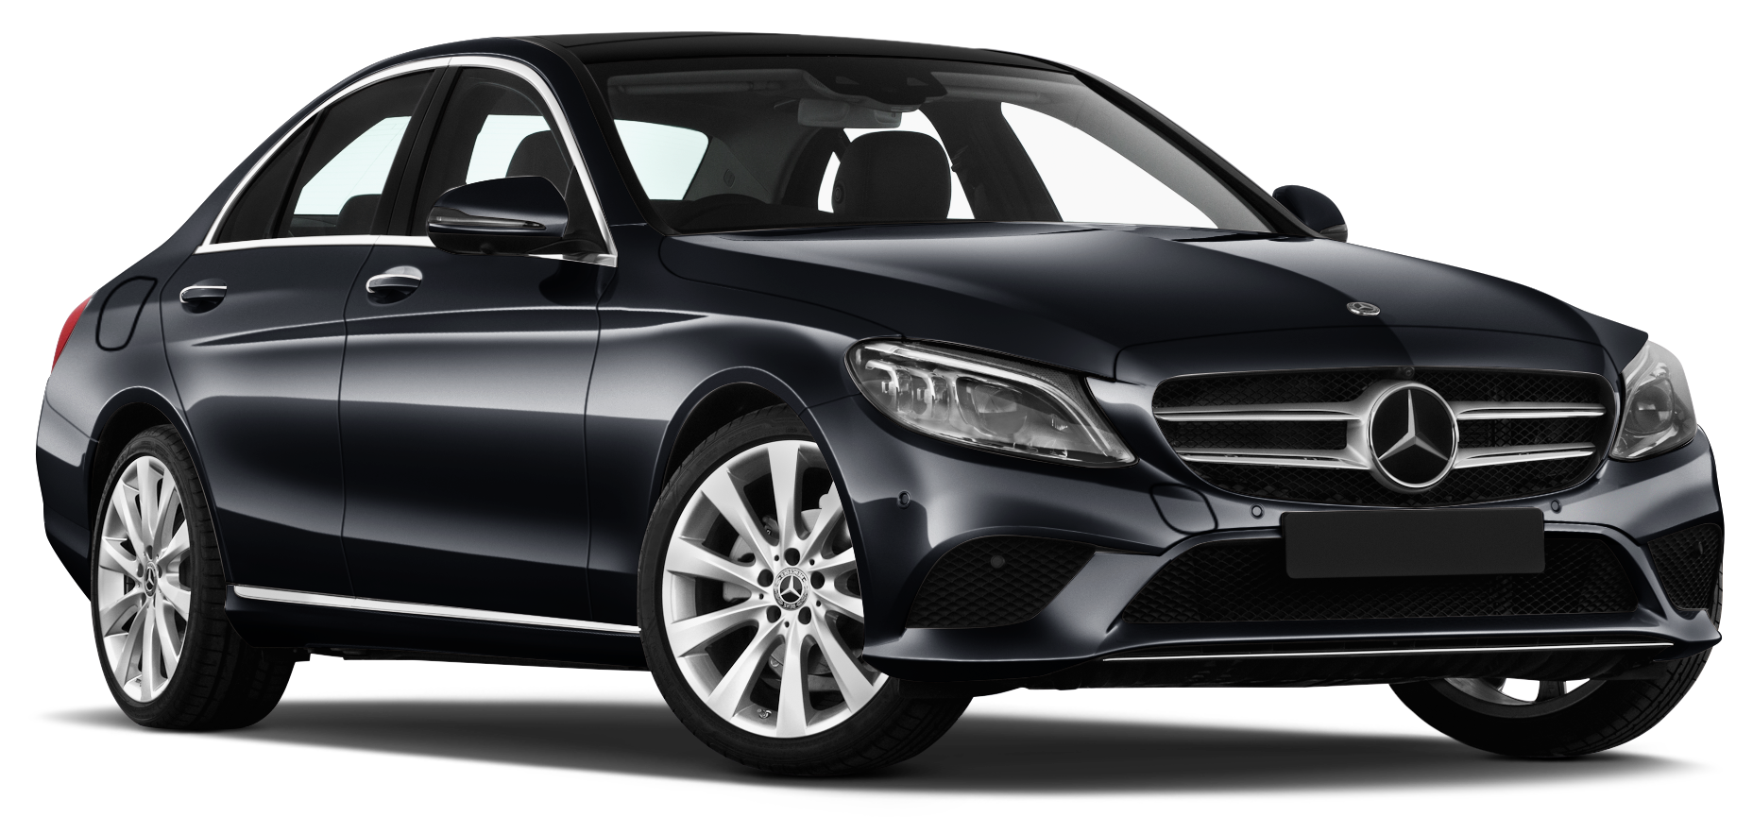
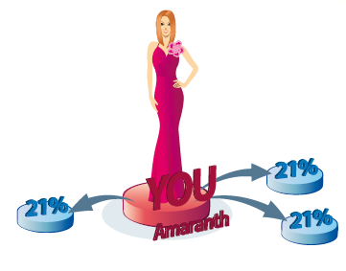
Amaranth Orchid
You receive the Amaranth Orchid title if you sponsor at least three groups (3 different legs) with an achievement level of at least 21% each.
£3,000
per month

Slide 22

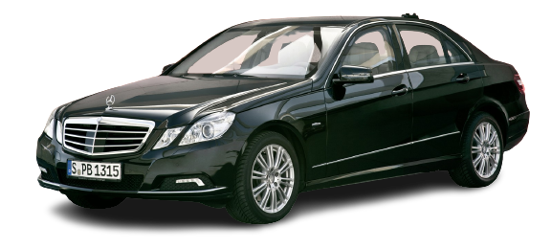
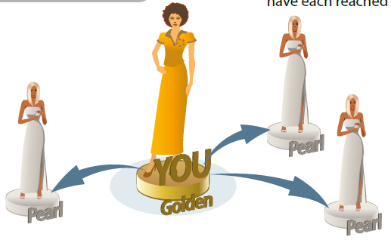
Golden Orchid
You receive the Golden Orchid title if you sponsor at least three groups in three different legs that have each reached any Orchid level.
£5,000
per month

Slide 23

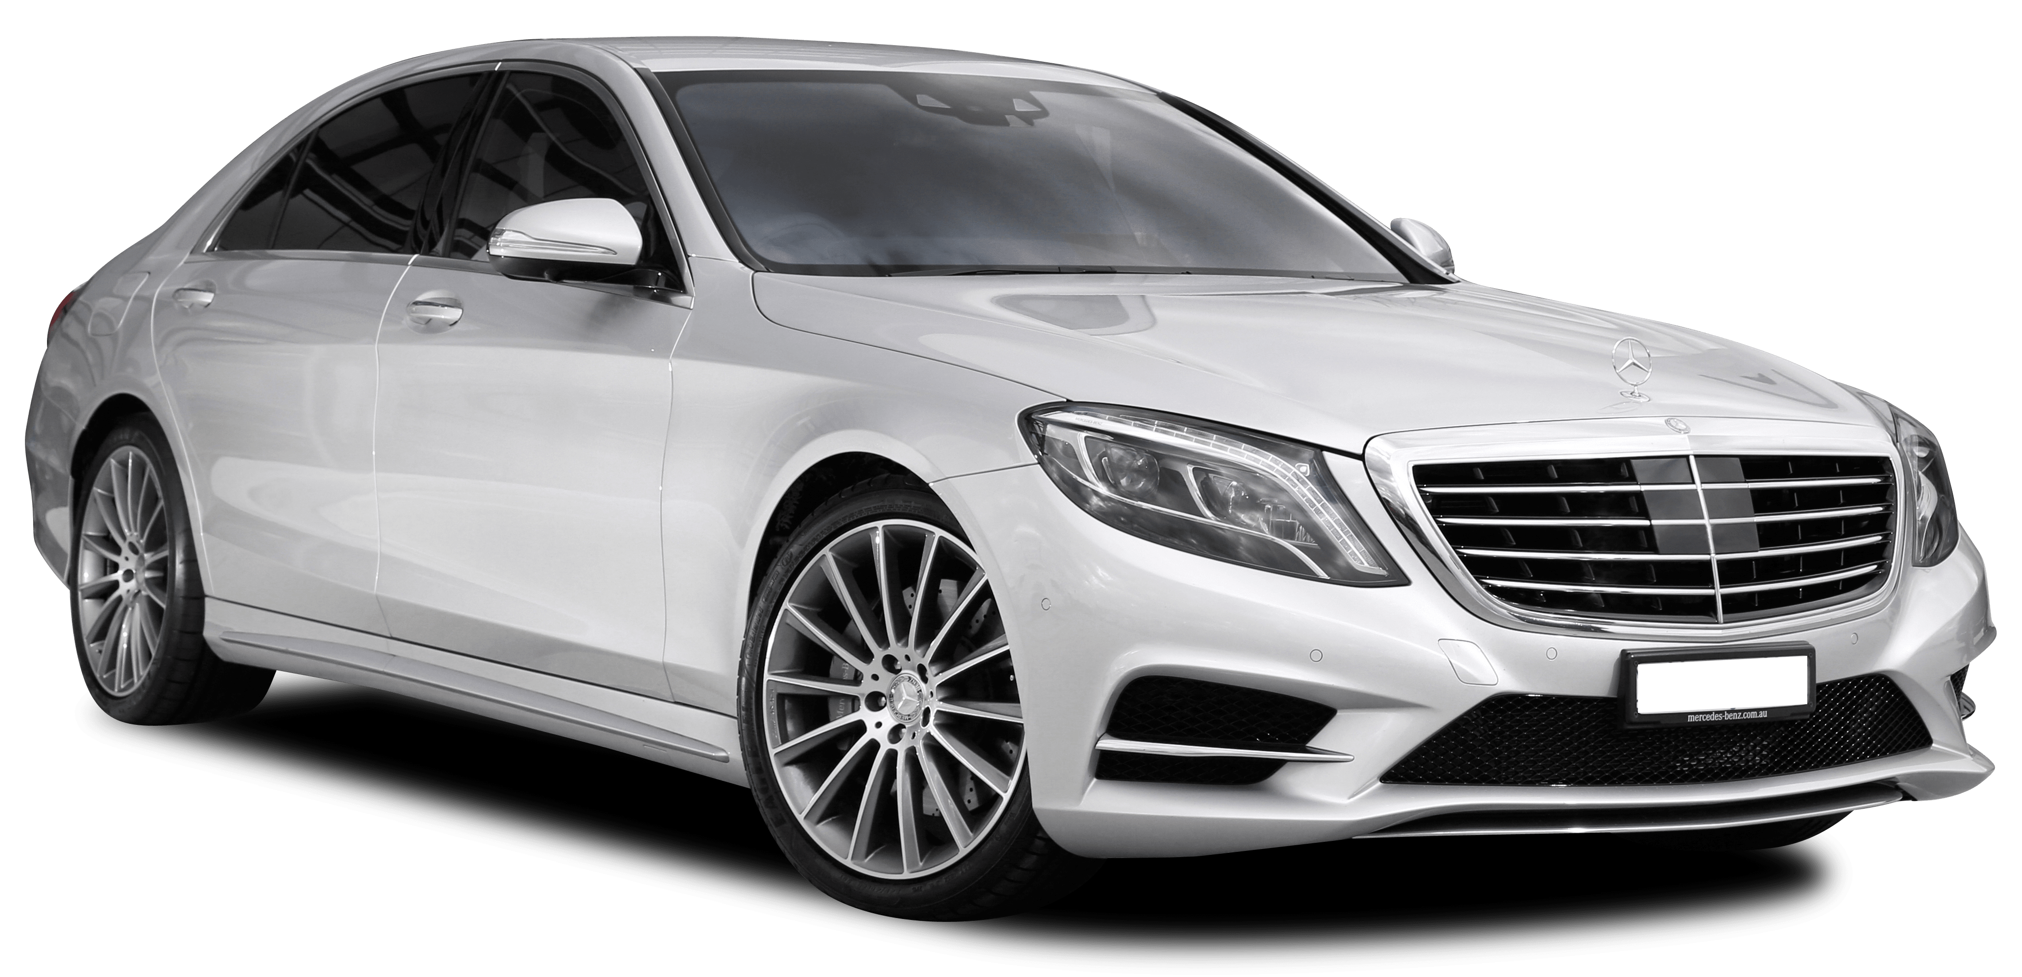
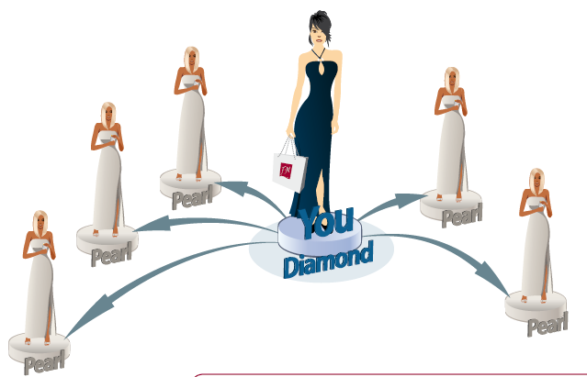
Diamond Orchid
You receive the Diamond Orchid title if you sponsor at least five groups in five different legs that have each reached an Orchid level.
£8,000
per month

Slide 24

Star Club
NEW ELITE STAR CLUB
Jasper Star
Amethyst Star
Malachite Star
Nephrite Star
Onyx Star
£25,000 - £250,000 per month

Slide 25
Fast Start
First Month
Second Month
Third Month
Fast Start Target Level:
The month you join FM World USA
Target Level: 15%
Reward: £400
Target Level: 21%
Reward: £800
First Month
Second Month
Third Month
Fourth Month
Fifth Month
Second Chance Target Level:
The month you join FM World USA
Target Level:
Not required
Target Level: 15%
Reward: £200
Target Level: min 15%
Target Level: 21%
Reward: £400

Slide 26
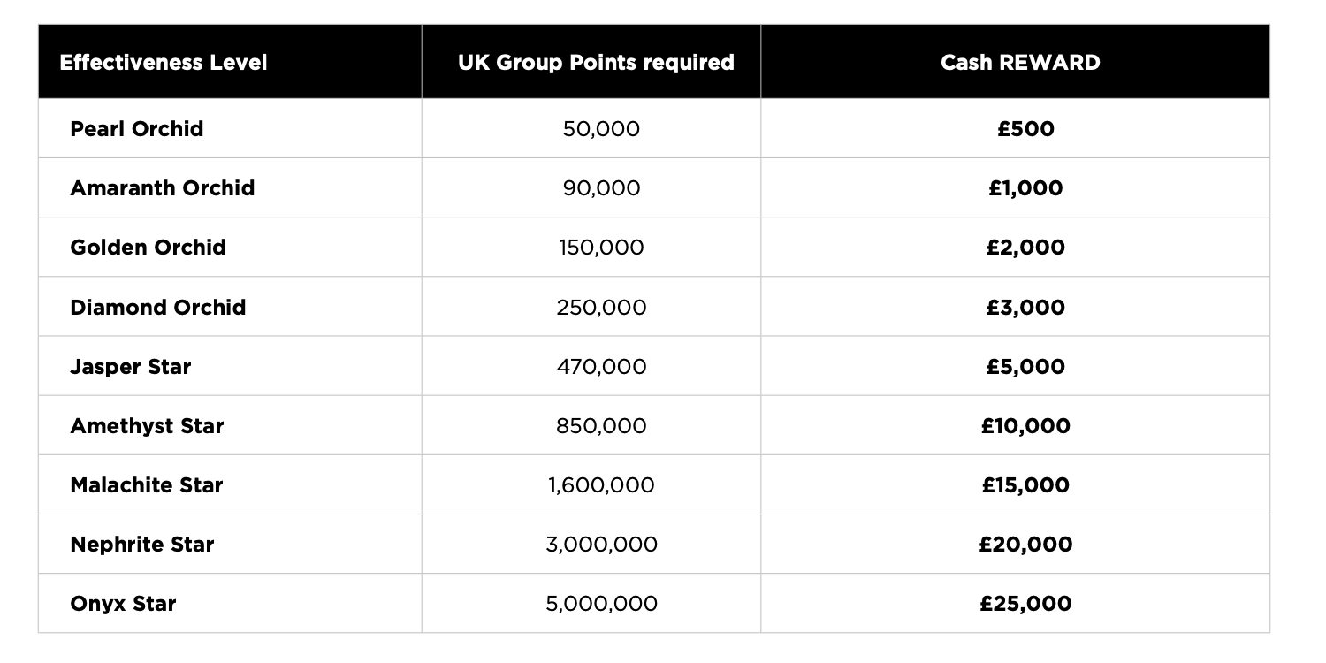
Get Rewarded

Slide 27
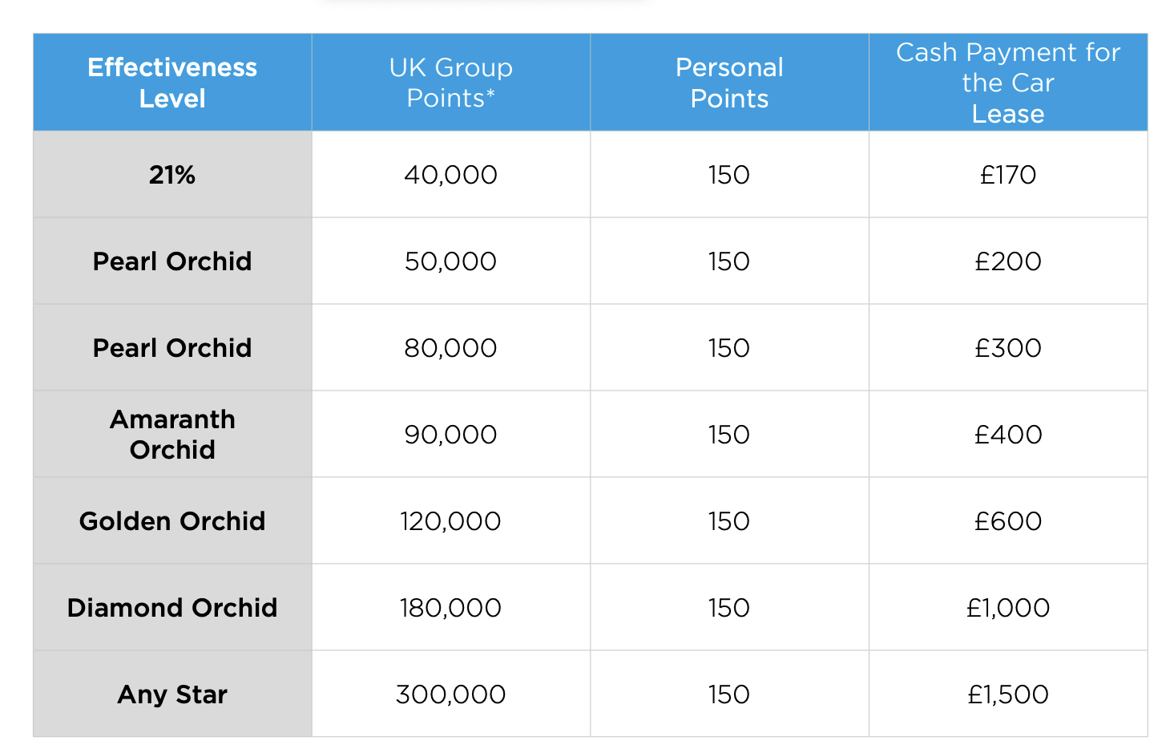
Drive For Success

Slide 28
Welcome Home
LEVEL | ADDITIONAL CONDITIONS |  |  | ELIGIBILITY
 | Downline number | Minimum point turnover of each downline | Personal Points
21% | 6 | 5000 | 100 | Super Bonus = 500 Euro
PEARL ORCHID | 6 | 5000 | 100 | Super Bonus = 500 Euro
AMARANTH ORCHID | 6 | 5000 | 100 | Super Bonus = 500 Euro
Take a look at the example of the required structure of Golden Magnolia:
GOLDEN MAGNOLIA
30 100
5000
5000
5000
5000
5000
5000

Slide 29


Thank You For Watching
Now Go Back To The Person Who Sent You This Video And They Will Show You How To Get Started

