Slide 1
TERRI OKE
Doing 300 Points

Slide 2
Do I have to??
Well answer these questions first:
Do you want to earn any bonus?
Do you want your team to earn any bonus?
Are you in business at all?
Are you Mr Tesco with Mr Sainsbury’s products on display?
TeamEagle-FM
Training

Slide 3
Okay so I have to but How?
If you haven’t learnt from Ian then you need to be the next volunteer!
Use your own products
Save friends from being ripped off
Perfume party – Have fun, get paid
Where are you buying your next gift
TeamEagle-FM
Training

Slide 4
But every month??
Do you want to earn any bonus?
Do you want your team to earn any bonus?
Are you in business at all?
Are you Mr Tesco with Mr Sainsbury’s products on display?
TeamEagle-FM
Training

Slide 5
Okay, okay, so when ?
At the start of the month.
Why??
You would be replacing products you used in the month right?
You want your team to duplicate you right?
You want to help your team right?
You are going for a new level right?
You want time to get new prospects right?
So do it at the start of the month!
TeamEagle-FM
Training

Slide 6
Do the maths!
You have got to reach Golden Magnolia before you can be Diamond!
750 people X 40 points = 21%
100 people X 300 points = 21%
Now do you want to do it the hard way or the easy way??
TeamEagle-FM
Training

Slide 7
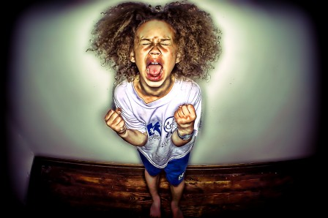
Terri stop being a baby and grow up!
TeamEagle-FM
Training

